Slide 1
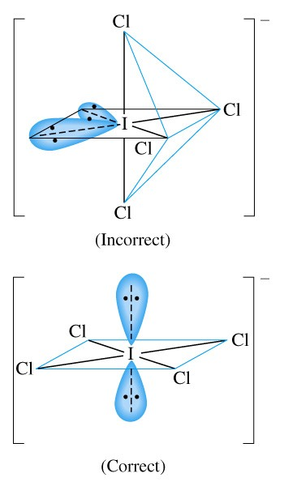
Chapter 11: Chemical Bonding I:
Basic Concepts
General Chemistry
Principles and Modern Applications
Petrucci • Harwood • Herring
8th Edition
Philip Dutton
University of Windsor, Canada
N9B 3P4
Prentice-Hall © 2002
Notes:
Thermochemistry branch of chemistry concerned with heat effects accompanying chemical reactions.
Direct and indirect measurement of heat.
Answer practical questions: why is natural gas a better fuel than coal, and why do fats have higher energy value than carbohydrates and protiens.

Slide 2
Contents
11-1 Lewis Theory: An Overview
11-2 Covalent Bonding: An Introduction
11-3 Polar Covalent Bonds
11-4 Writing Lewis Structures
11-5 Resonance
11-6 Exceptions to the Octet Rule
11-7 The Shapes of Molecules
11-8 Bond Order and Bond Lengths
11-9 Bond Energies
Focus on Polymers—
Macromolecular Substances

Slide 3
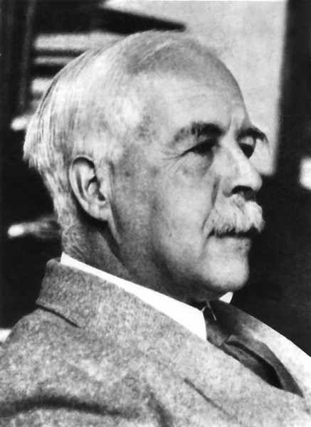
11-1 Lewis Theory: An Overview
Valence e⁻ play a fundamental role in chemical bonding.
e⁻ transfer leads to ionic bonds.
Sharing of e⁻ leads to covalent bonds.
e⁻ are transferred of shared to give each atom a noble gas configuration
  the octet.

Slide 4
Lewis Symbols
A chemical symbol represents the nucleus and the core e⁻.
Dots around the symbol represent valence e⁻.
•
Si
•
•
•
••
••
••
••
••
N
P
As
Sb
Bi
•
•
•
•
•
•
•
•
•
•
•
•
•
•
•
Al
••
••
••
•
Ar
•
•
Se
••
I
••
•
•
••
•
•
••
••

Slide 5
Lewis Structures for Ionic Compounds
BaO
•
••
2+
••
2-
Ba
O
Ba
••
O
•
•
•
••
••
••
••
Cl
•
••
•
••
2+
••
-
MgCl₂
Mg
Mg
2
Cl
•
••
••
••
••
Cl
•
••
••
Notes:
Binary ionic compounds.
Note the types of arrows used to move electrons – fishhooks for single e⁻.
Write the Lewis symbol for each atom
Determine how many e⁻ each atom must gain or lose.
Use multiples of one or both ions to balance the number of electrons.

Slide 6
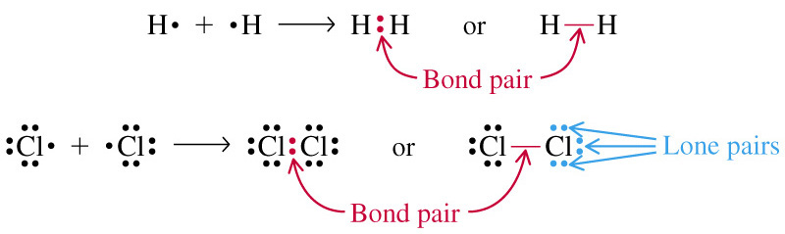
11-2 Covalent Bonding

Slide 7
Coordinate Covalent Bonds
+
H
H
••
-
H
Cl
Cl
N
H
••
H
••
H
N
••
••
H
H
Notes:
Note double headed arrow for two electron movement

Slide 8
Multiple Covalent Bonds
•
•
•
•
•
•
O
••
C
••
• •
C
O
O
O
•
•
•
•
• •
• •
•
• •
••
•
••
••
•
•
•
••
••
C
••
O
C
O
O
O
••
•
••
••
••

Slide 9
Multiple Covalent Bonds
•
•
•
•
N
••
N
N
••
N
••
••
•
•
•
•
•
•
•
N
N
N
N
••
••
••
••
•

Slide 10
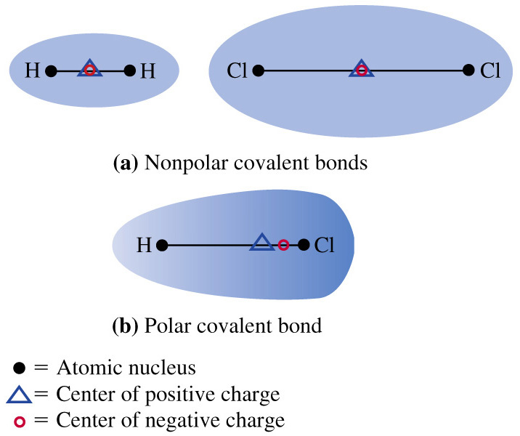
11-3 Polar Covalent Bonds
δ+
δ-
H
Cl

Slide 11
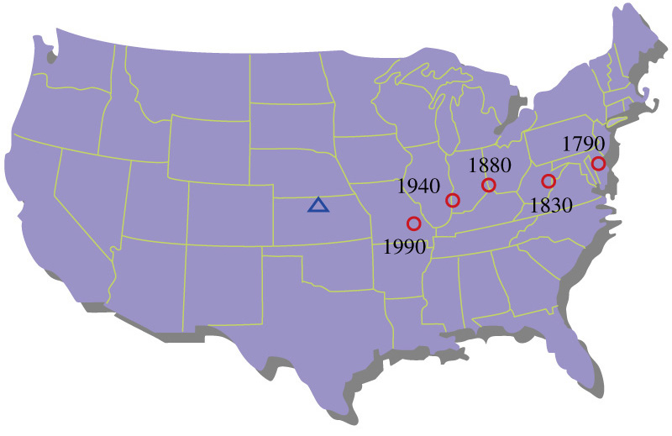
Analogy to Population

Slide 12
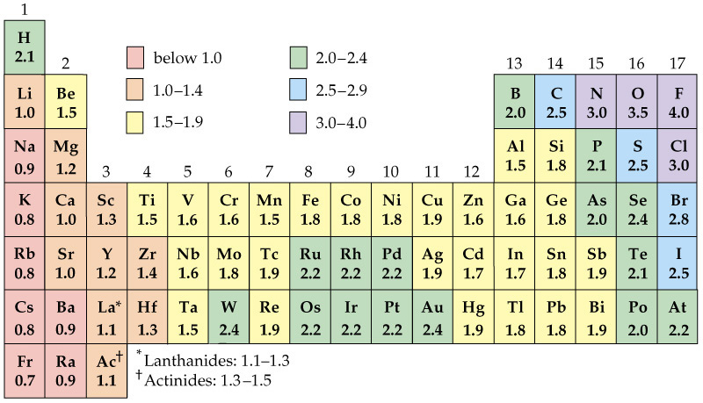
Electronegativity

Slide 13
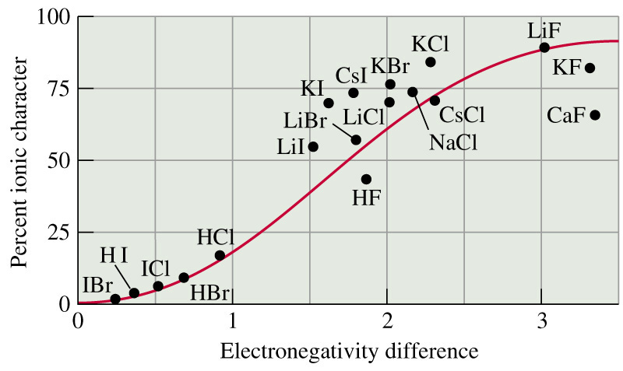
Percent Ionic Character

Slide 14
Writing Lewis Structures
All the valence e⁻ of atoms must appear.
Usually, the e⁻ are paired.
Usually, each atom requires an octet.
  H only requires 2 e⁻.
Multiple bonds may be needed.
  Readily formed by C, N, O, S, and P.

Slide 15
Skeletal Structure
Identify central and terminal atoms.
H
H
H
C
C
O
H
H
H

Slide 16
Skeletal Structure
Hydrogen atoms are always terminal atoms.
Central atoms are generally those with the lowest electronegativity.
Carbon atoms are always central atoms.
Generally structures are compact and symmetrical.
Notes:
H can only accommodate two electrons
H and O are common exceptions to rule 2
Organic compounds are not compact nor symmetrical.

Slide 17
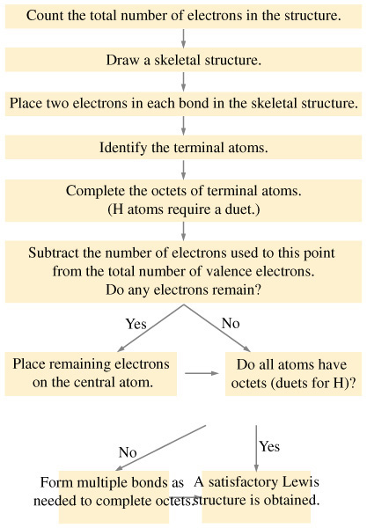
Strategy for Writing Lewis Structures

Slide 18
Formal Charge
FC = #_{valence e-} - #_{lone pair e-} -
1
#_{bond pair e-}
2
Notes:
The formal charge on an atom in a Lewis structure is the number of valence e⁻ in the free atom minus the number of e⁻ assigned to that atom in the Lewis structure.

Slide 19
Example 11-6
Writing a lewis Structure for a Polyatomic Ion.
Write the Lewis structure for the nitronium ion, NO₂⁺.
Step 1:
Total valence e⁻ = 5 + 6 + 6 – 1 = 16 e⁻
Step 2:
Plausible structure: O—N—O
Step 3:
••
••
Add e⁻ to terminal atoms: O—N—O
••
••
••
••
Step 4:
Determine e⁻ left over: 16 – 4 – 12 = 0

Slide 20
Example 11-6
Step 5:
Use multiple bonds to satisfy octets.
••
••
••
+
••
O—N—O
O=N=O
••
••
••
••
••
••
Step 6:
Determine formal charges:
1
FC(O) = 6 - 4 – (4) = 0
2
1
FC(N) = 5 - 0 – (8) = +1
2

Slide 21
Alternative Lewis Structure
••
••
+
+
-
••
O—N—O
••
••
••
••
O N O
••
••
••
1
FC(O≡) = 6 - 2 – (6) = +1
2
1
FC(N) = 5 - 0 – (8) = +1
2
1
FC(O—) = 6 - 6 – (2) = -1
2

Slide 22
Alternative Lewis Structures
Sum of FC is the overall charge.
FC should be as small as possible.
Negative FC usually on most electronegative elements.
FC of same sign on adjacent atoms is unlikely.
-
+
+
••
O≡N—O
••
••
••

Slide 23
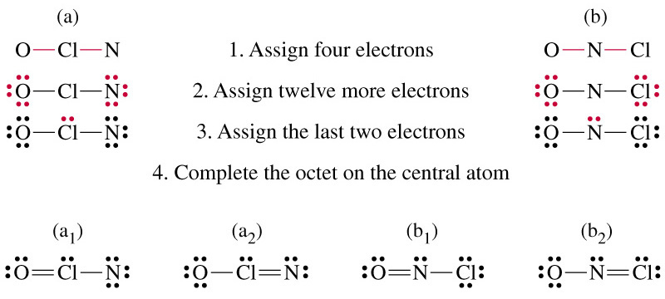
Example 11-7
Using the Formal Charge Concept in Writing Lewis Structures.
Write the most plausible Lewis structure of nitrosyl chloride, NOCl, one of the oxidizing agents present in aqua regia.
2+
2-
-
2+
-
-
+

Slide 24
11-5 Resonance
+
-
-
+
••
••
••
••
••
••
O
O
O
O
O
O
••
••
••
••
••
••
-½
+
-½
••
••
••
O
O
O
••
••
Notes:
Many Lewis structures may be written for a given structure..
Ozone has two good possibilities, but neither gives the correct structure that has two equivalent O-O bonds.

Slide 25
11-6 Exceptions to the Octet Rule
Odd e⁻ species.
N=O
•
••
••
••
H
••
O—H
H—C—H
•
•
••
Notes:
H

Slide 26
Exceptions to the Octet Rule
Incomplete octets.
••
••
••
••
••
F
••
F
••
F
••
••
-
+
B
B
B
••
••
••
-
••
••
F
••
••
F
F
••
F
••
F
F
+
••
••
••
••
••
••
••
••
••
••
••

Slide 27
Exceptions to the Octet Rule
Expanded octets.
••
••
••
••
••
F
Cl
••
••
Cl
••
••
••
••
••
••
••
••
F
Cl
F
Cl
••
••
••
••
P
••
••
S
••
P
••
••
••
••
••
••
F
F
Cl
Cl
Cl
Cl
••
••
••
••
••
••
••
••
••
••
••
••
F
••
••
••

Slide 28
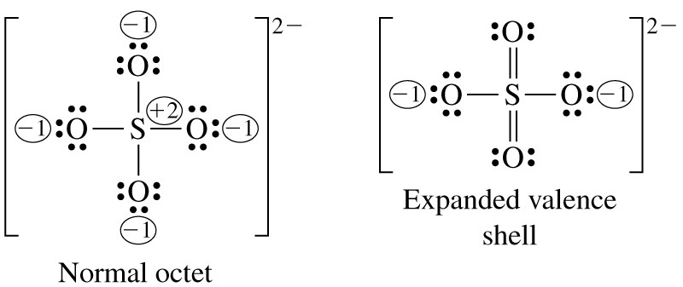
Expanded Valence Shell
Notes:
It is not clear which is the more correct representation.

Slide 29
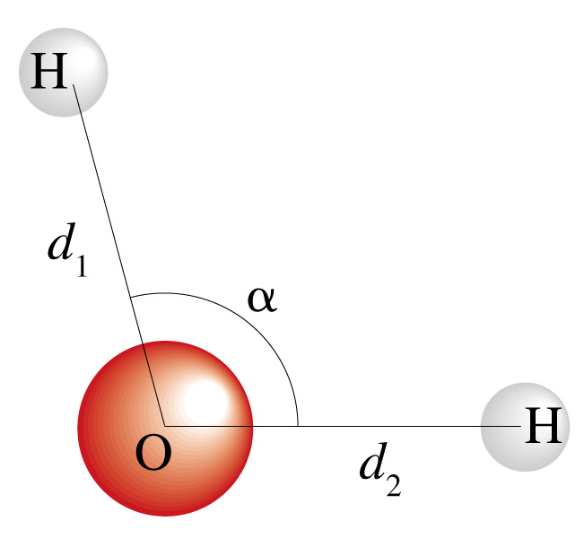
11-7 The Shapes of Molecules
H O H

Slide 30
Terminology
Bond length – distance between nuclei.
Bond angle – angle between adjacent bonds.
VSEPR Theory
  Electron pairs repel each other whether they are in chemical bonds (bond pairs) or unshared (lone pairs). Electron pairs assume orientations about an atom to minimize repulsions.
Electron group geometry – distribution of e⁻ pairs.
Molecular geometry – distribution of nuclei.

Slide 31
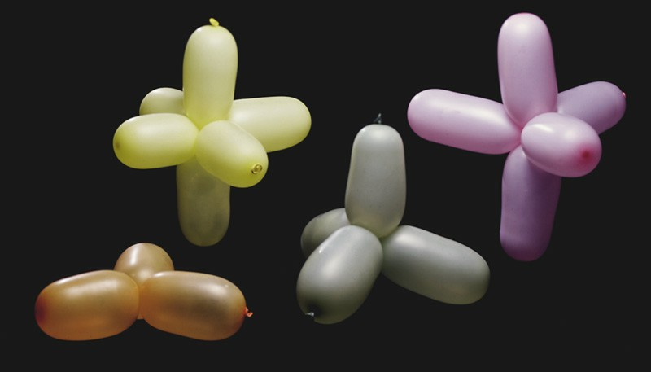
Balloon Analogy

Slide 32
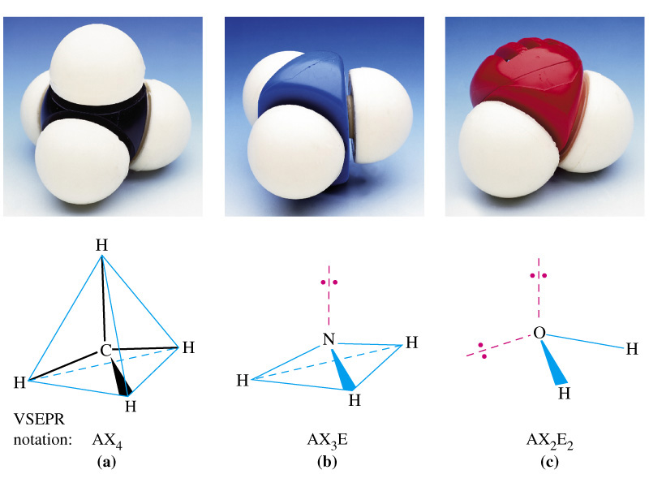
Methane, Ammonia and Water

Slide 33
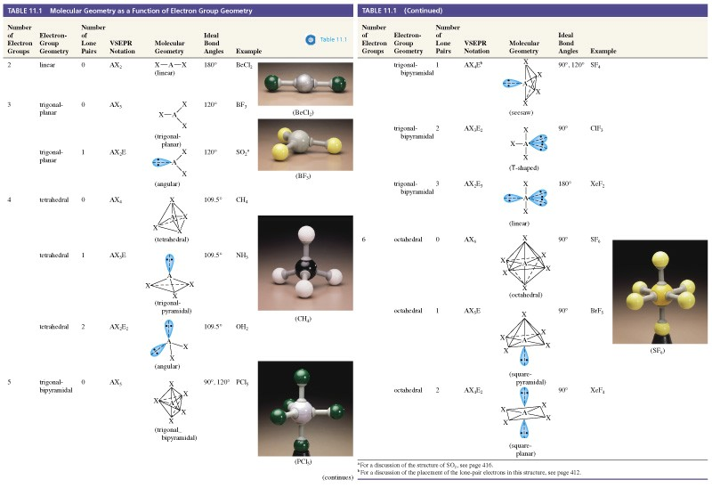
Table 11.1 Molecular Geometry as a Function of Electron Group Geometry

Slide 34
Applying VSEPR Theory
Draw a plausible Lewis structure.
Determine the number of e⁻ groups and identify them as bond or lone pairs.
Establish the e⁻ group geometry.
Determine the molecular geometry.
Multiple bonds count as one group of electrons.
More than one central atom can be handled individually.

Slide 35
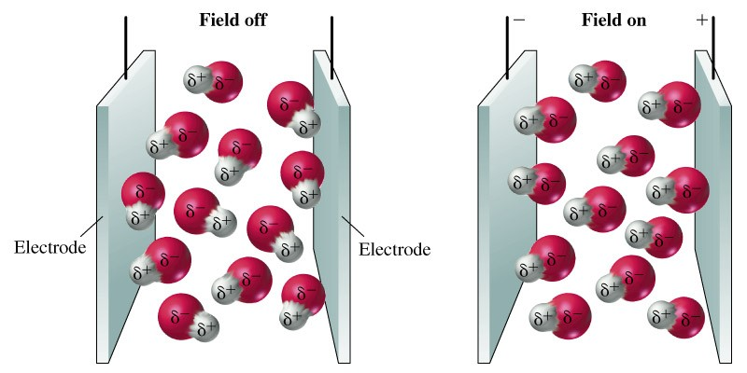
Dipole Moments
Notes:
Ana electrical condenser (or capacitor) consists of a pair of electrodes separated by a medium that does not conduct electricity. When the field is off the molecules orient randomly. When the filed is on the molecules align with the field. The alignment can be detected.

Slide 36
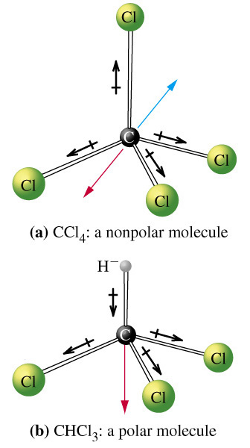
Dipole Moments
Notes:
HCl is a polar molecule

Slide 37
Bond Order and Bond Length
Bond Order
  Single bond, order = 1
  Double bond, order = 2
Bond Length
  Distance between two nuclei
Higher bond order
  Shorter bond
  Stronger bond

Slide 38
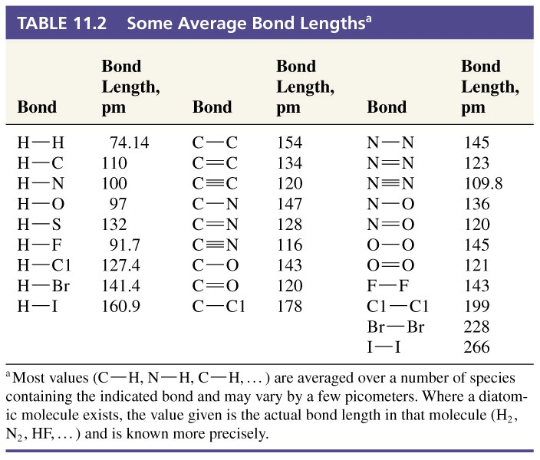
Bond Length

Slide 39
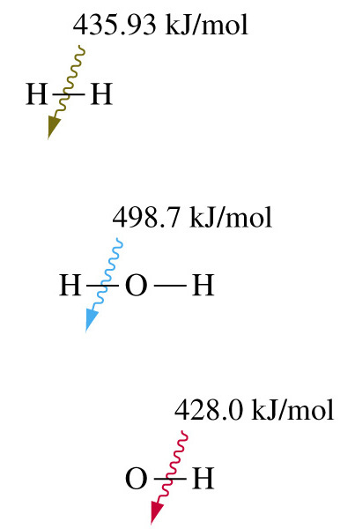
Bond Energies

Slide 40
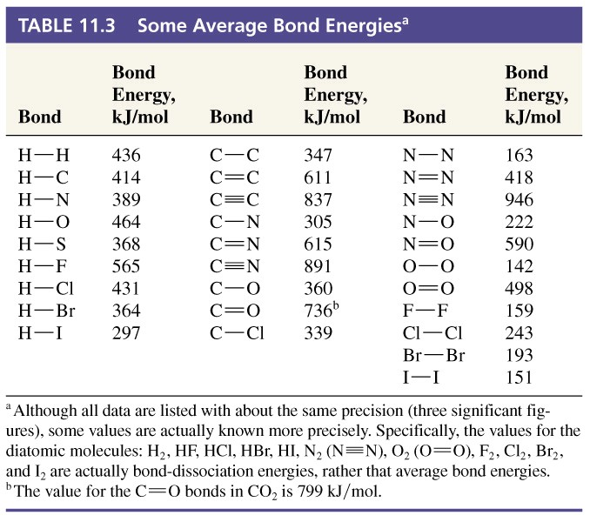
Bond Energies

Slide 41
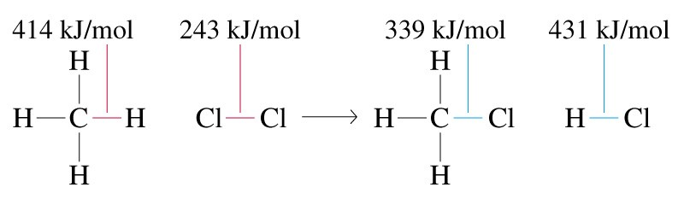
Bond Energies and Enthalpy of Reaction
ΔH_{rxn} =  ΔH(product bonds) - ΔH(reactant bonds)
=  ΔH bonds formed -  ΔH bonds broken
= -770 kJ/mol – (657 kJ/mol) = -114 kJ/mol
Notes:
You can use bond energies in exactly the same way you can use enthalpies of formation. Enthalpy of formation is more accurately known and bond energy is usually an average, but it can be used effectively if formation data is unavailable.

Slide 42
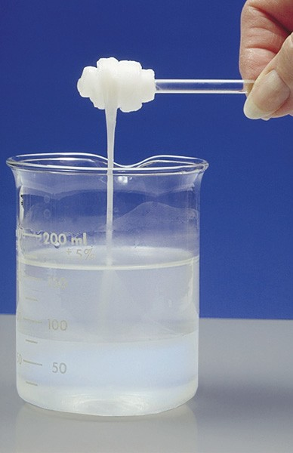
Focus on Polymers – Macromolecular Substances

Slide 43
Chapter 11 Questions
1, 4, 6, 8, 10, 11, 15, 27, 33, 37, 53, 57, 65 (also calculate formal charges), 71, 86, 94

